Slide 1
Menu Solutions with Land O Lakes® Products, Recipes & Resources
Rick McCain
Chef Fernando Mojica
Lo Gauna
February 2026

Slide 2
Agenda
Introduction
Company Overview
Product Insights
Simple Stir In Activity
Recipe Tasting & Discussion

Slide 3
Land O’Lakes Overview

Slide 4
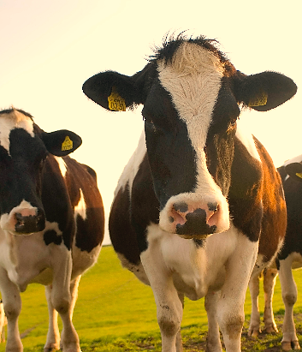
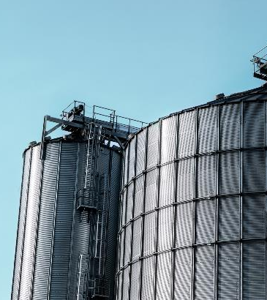
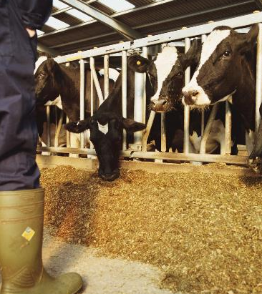
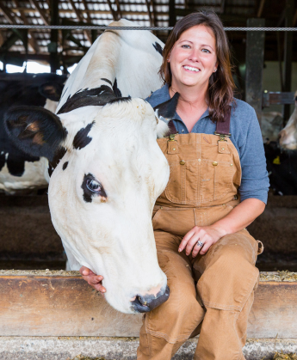
FARMER-OWNED COOPERATIVE
1,700+
DAIRY PRODUCERS
UNIQUE FARM-TO-FORK VIEW
POWERFUL, RESPECTED
BRANDS
Notes:
Laura
When you think of Land O’Lakes, Inc., I’m sure many think of it as “the butter business”
While we are certainly proud of the success we’ve achieved with our butter products, the truth is, we are a whole lot more than butter.
Land O’Lakes is a farmer-owned cooperative – owned by individual dairy farmers and agricultural retailers (co-ops).
We have a very unique farm(er) to fork view of the food and agriculture business.
You’ll see shortly that we are home to some very powerful and respected brands – among them our butter brand.
We also have industry leading operations in all the segments in which we operate.

Slide 5
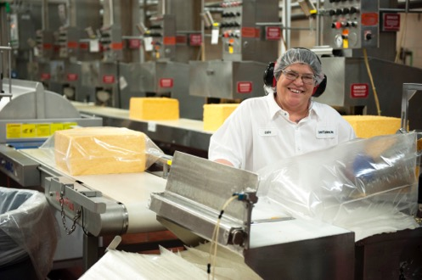
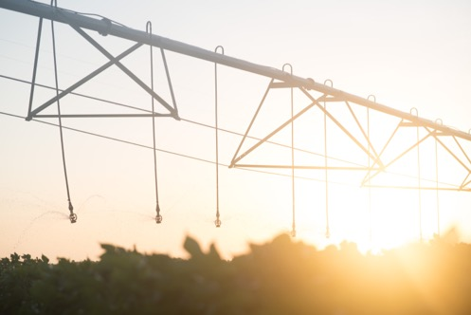
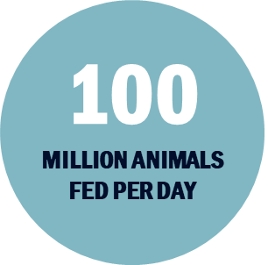

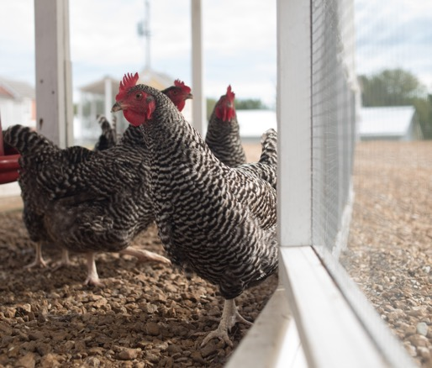


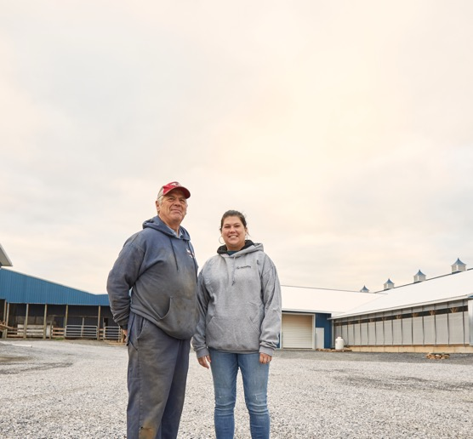
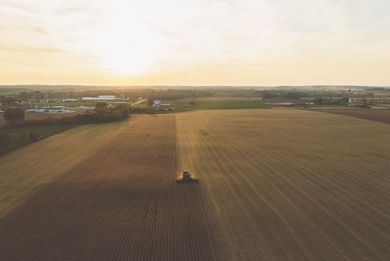
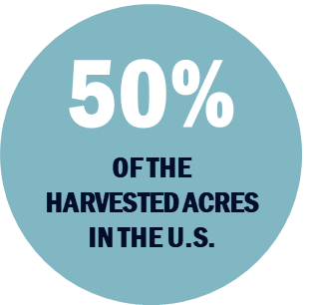
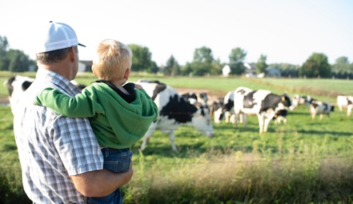

500K+
Metric Tons of Carbon sequestered
We’re a farmer-owned cooperative. Proud of our butter, and so much more.
12.9
BILLION POUNDS OF MILK
#26
Fortune’s Most Powerful Women List
Notes:
Laura
Land O’Lakes, Inc. is a 100-year-old farmer- and retailer-owned cooperative originally formed with the purpose of working together to create new market opportunities.
Through our cooperative network, we touch 50% of the harvested acres in the United States and 25% of domestic producers
Our dairy farmers produce over 12 billion pounds of milk each year
Our Animal Nutrition business feeds 100 million animals per day
We are recognized by the media for our impact as well – top 100 most influential company in 2023.
Our CEO Beth Ford was recognized as Fortune’s most powerful women list

Slide 6

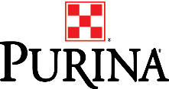










We operate four diversified agribusinesses, giving us a unique “Farm to Fork” view
Crop Inputs & Insights
Agricultural products, data, technology tools and services
We touch 50% of the harvested acres in the U.S. through 1,000 ag cooperatives
Animal Nutrition
Solutions that enhance performance and well-being We feed 100 million animals daily using 100+ patents in animal feed innovation
Sustainability
Environmental stewardship and farm profitability solutions
Agronomic and environmental data insights and grower decision support tools to power on farm sustainability
Dairy Foods
Milk-based products and ingredients
Over 1300+ farmer owners producing 13 Billion LBS of milk annually
Production FARM to FORK Consumer
Notes:
Laura
Today, our four businesses give us a unique view of agriculture. Pair this with our farmer ownership and we’re uniquely qualified to better serve customers and consumers, while always delivering on our responsibility to our member-owners.
We talk a lot about our unique view of agriculture and food that spans the ecosystem of agriculture.
This visual shows the ways in which Land O’Lakes is involved from leading agricultural research, the crop inputs that grow into grain that animals eat to produce the milk, to R&D and value-added product development, to marketing and sales of branded goods. We are there every step of the way from the farm to the family table.
This is very unique set-up and we take pride in it.
Our unique end-to-end view is brought to life in our four diversified business units – each driven by insights and innovation.
Purina is the primary brand of our animal nutrition portfolio, which is focused on delivering nutrition solutions that enhance animal performance and well-being.
We believe animals make the world a better place. And the way we nourish them makes all the difference.
It’s this belief that inspires our industry-leading R&D and committed partnerships, we innovate with nutritional technologies and practices that advance the way we nurture animals to expand the positive impact they have on our world.
This team feeds over 100 million animals a day across a diverse portfolio of brands, anchored in our Animal Nutrition business. The portfolio includes Purina as well as our Mazuri Exotic Animal Nutrition Business, our Nutra Blend Distribution company, PMI Feed Microprocessors, and our Exclusive Pet Nutrition brands. Providing end-to-end solutions for the animal nutrition industry.
WinField United is the primary brand of our Crop Inputs and Insights portfolio. This is our home for agricultural products (seed, CPP, crop nutrients), data, technology tools and services.
The Crop Inputs and Insights portfolio is built on our belief that we can get more from our land efficiently and responsibly and that this effort is vital to supporting our growing population.
By combining our leading expertise, high quality products, rich data and innovative technology, we work to help agricultural retailers and the farmers they serve intelligently advance agriculture and win in every field around the world.
We deliver seed, crop protection products and crop nutrients and we add value through one of the industries most comprehensive Ag Technology platforms that take our owned tools and those of partners to deliver technology solutions that help farmers invest well in their acres to get predictable outcomes.
LAND O LAKES is the primary brand of our dairy foods business. This portfolio is all about milk-based products and ingredients.
Perhaps our most well-known portfolio is the dairy portfolio. This portfolio is anchored in the belief that there’s powerful potential in every drop of milk our farmers produce.
By improving production and finding innovative uses for that milk, we add a little good to people’s lives and, together, enable humanity to thrive.
Our butter is well-known among a portfolio of delicious dairy products. We are proud of our work in cheese, specialty cheese powders and the role non-fat powdered milk plays as an ingredient.
This portfolio also includes Kozy Shack refrigerated desserts, as well as Vermont Creamery and their artisanal cheeses and award-winning creme fraiche.
Truterra is our business working to enhance farmer-led stewardship, helping to protect and improve working lands and, helping companies honor their climate commitments.
Truterra is focused on developing and delivering solutions that address environmental sustainability and bolster farmer-led stewardship.
First, we position farmers for success by providing them tools and resources to track progress and continuously improve on every acre they farm. That helps to drive improvements in water, soil and air quality, which is good for the planet and also makes a farmer’s business resilient over the long term.
At the other end of the supply chain, Truterra partners with companies to make sustainability commitments actionable, practical and aligned with what farmers are already doing – as well as pushing areas of innovation on-farm.
Across all we do, we help farmers focus on both environmental sustainability and the economic sustainability of their business.

Slide 7

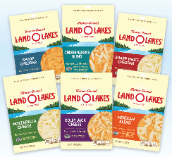
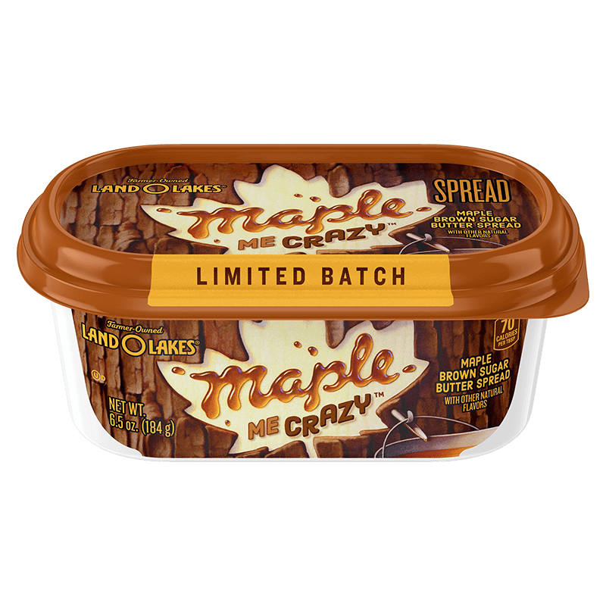
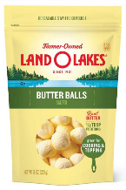
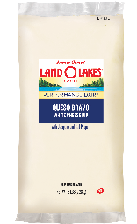
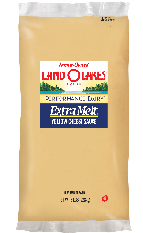
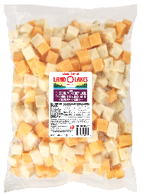





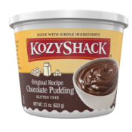
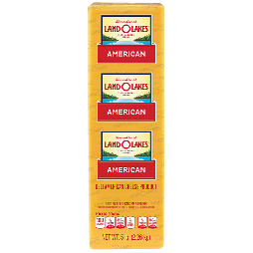
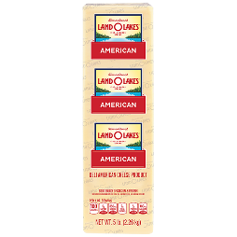

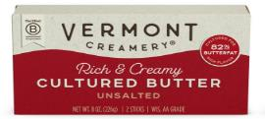
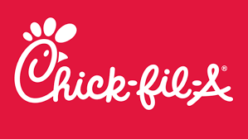
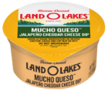
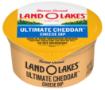

Dairy Foods
The Land O’Lakes name is synonymous with the highest quality dairy products.
Today, our diverse array of milk-based products and ingredients remain an icon in our nation’s kitchens and restaurants, as well as a key ingredient to food manufacturers around the world.
Retail Consumer Packaged Goods
Leadership positions in Butter, Cheese, Pudding, and Specialty Dairy
Foodservice
Products that make it easier for Restaurants and Schools to consistently make the food people love
Global Dairy Ingredients
Provides milk powder and seasonings for some of your favorite snacks and some of the largest global dairy providers in the world
Notes:
Jim
Our goal in Dairy Foods is to use our member milk to create value added products. We do this in retail channels with the butter you know and love, in Foodservice with cheese products, and in Global Dairy ingredients with milk powders.

Slide 8
Land O’Lakes K12 Product Portfolio

Slide 9
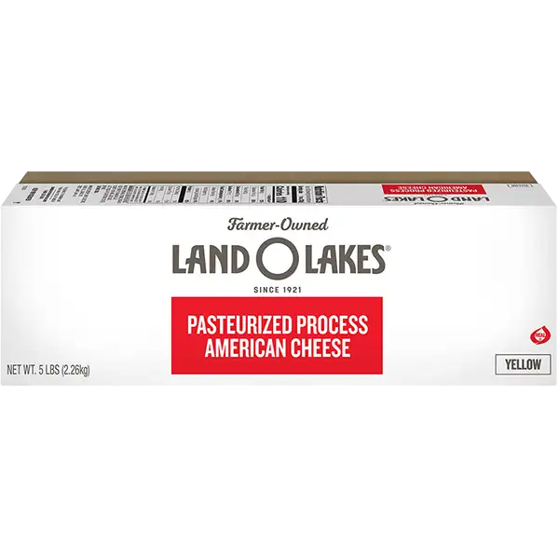
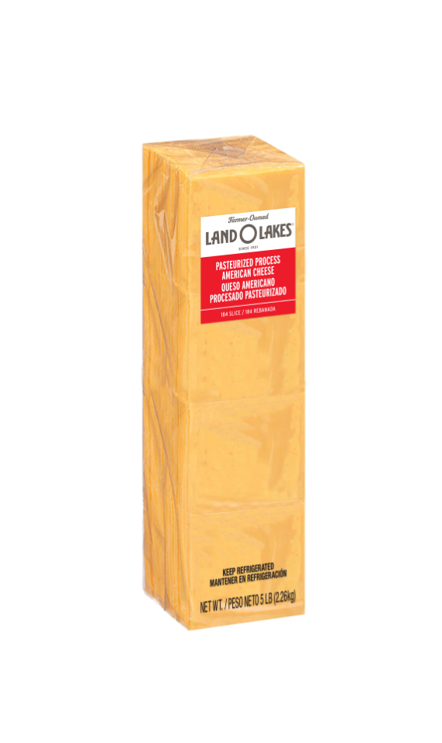
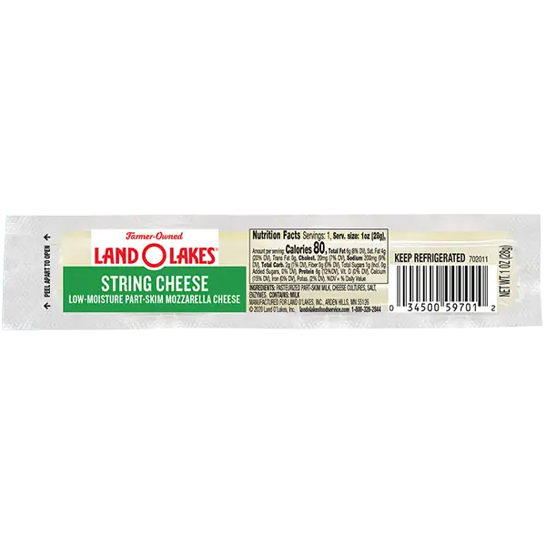
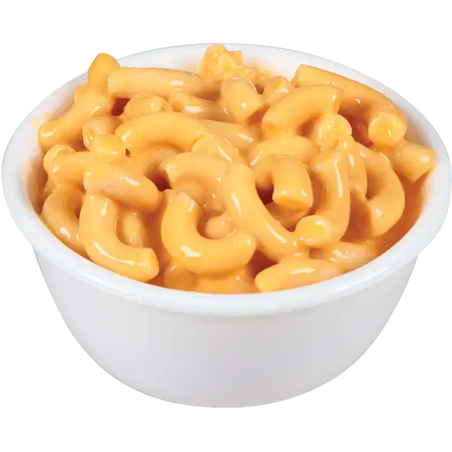
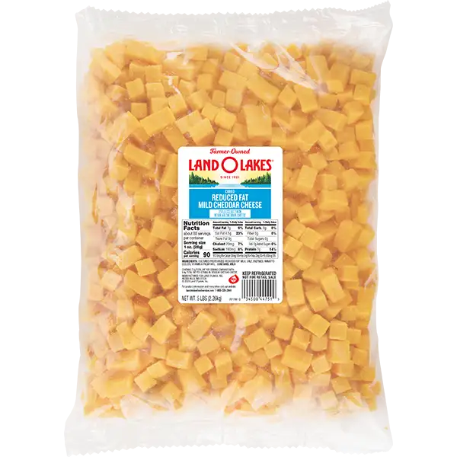
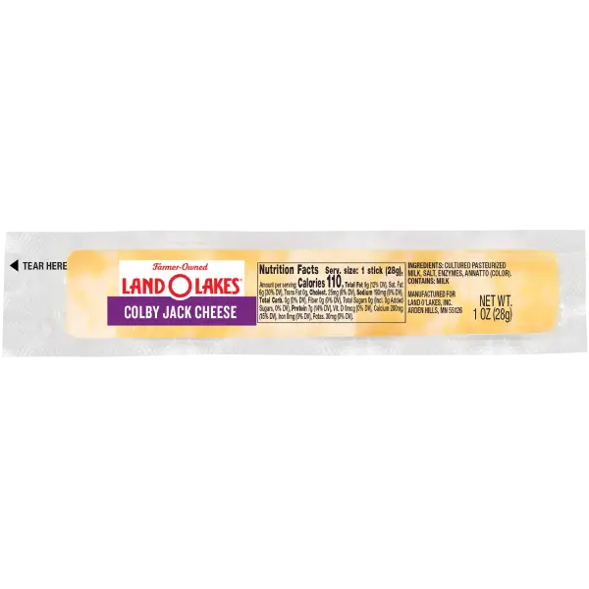
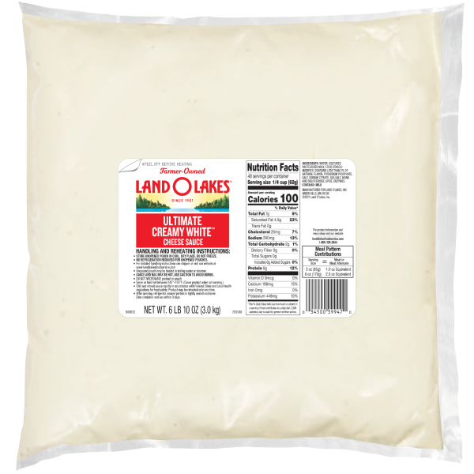
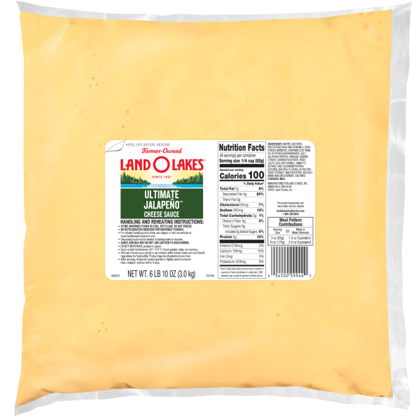
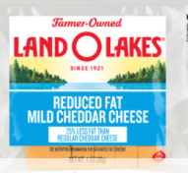
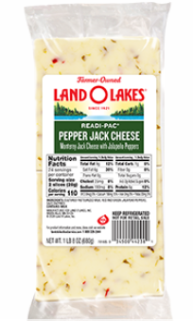
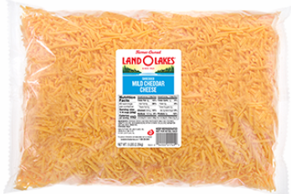
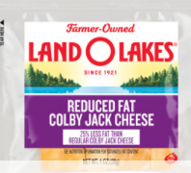
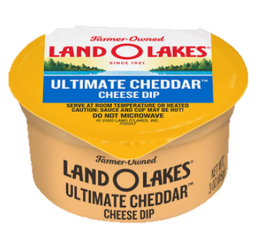
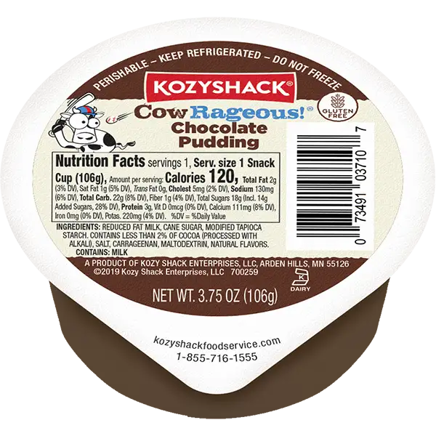
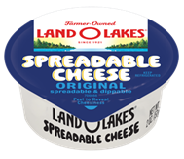
Land O’Lakes K12 Product Portfolio
Cheese Sauce
Macaroni and Cheese
Cheese
Grab and Go
Ultimate Creamy WhiteTM Cheese Sauce
Ultimate YellowTM Cheese Sauce
Ultimate JalapeñoTM Cheese Sauce
Macaroni and Cheese with Whole Grain
25% Reduced Sodium, 50% Reduced Fat Macaroni and Cheese with Whole Grain
50% Reduced Fat Macaroni and Cheese with Whole Grain
50% Reduced Fat Macaroni and Cheese
Slices
Redi-Pac® Slices
Loaf
Shreds
Sticks
Cubes
Dip Cups
Mozzarella String Cheese
Kozy Shack ® Pudding
Spreadable Cheese
Allocating commodity lbs. to code 110242 gives you access to Land O’ Lakes entire product portfolio.

Slide 10
Sauce FAQs

Slide 11
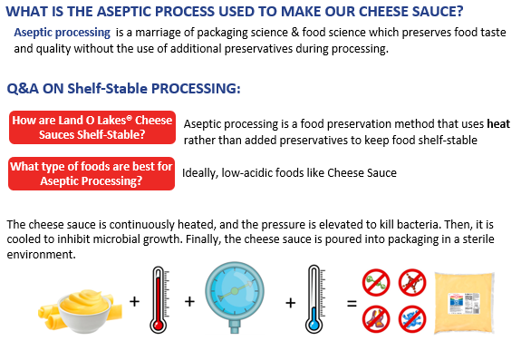
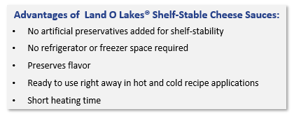
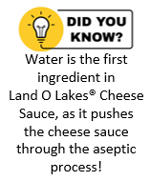
Why are Land O’ Lakes Cheese Sauces Shelf-Stable?
Notes:
MUST OMIT this slide when sharing deck externally with customer

Slide 12
Stir-In Activity

Slide 13
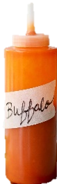
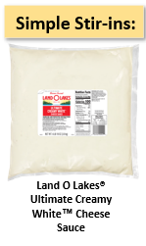
One Sauce - Endless Possibilities!
+ Buffalo Style Sauce & Cayenne = Cheesy Buffalo Sauce
+ Dried Dill Weed & Onion Powder = Dill Sauce
+ Curry Powder = Curry Cheese Sauce
+ Green Chiles & Jalapenos= Three Ingredient Queso
+ Sweet Chile Sauce & Sriracha = Sweet Sriracha Chile Sauce
+ Gochujang Paste & Sriracha = Korean Inspired Cheese Sauce
+ Italian Seasoning = Northern Italian Sauce
+ Marinara Sauce + Granulated Garlic = Blush Pasta Sauce
+ Tomato Paste & water = Rosa Sauce
+ Pureed Roasted Red Pepper = Roasted Red Pepper Dipping Sauce
+ No Sodium Mexican Seasoning = Southwestern Alfredo
+ Garlic Powder & Parmesan = Ultimate Alfredo
+ Mediterranean Seasoning = Mediterranean Cheese Sauce
+ Creamy Glaze = Creamy Glaze Recipe
Buffalo Sauce +854% growth at K12 Schools!

Slide 14
You may proceed to the food line.
Please make sure you take some of each recipe.

Slide 15
Recipes – Cheese Sauce and Shreds

Slide 16
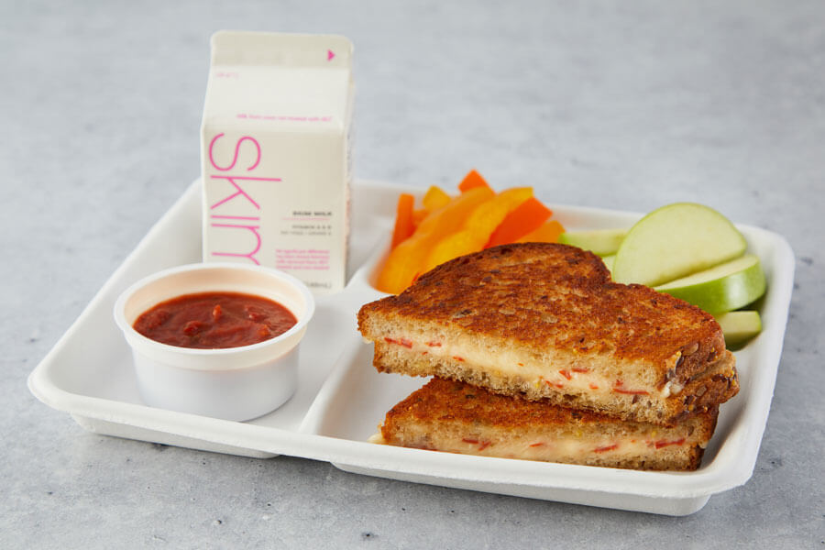
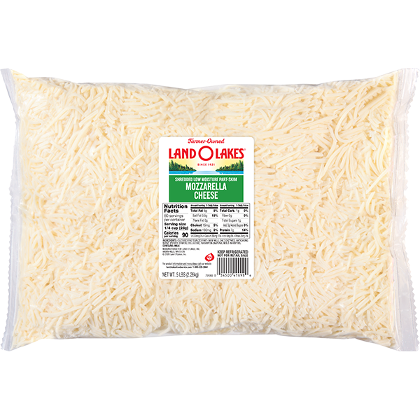
Pizza Grilled Cheese Recipe
Pizza Grilled Cheese
Serving Size: 1 sandwich [3.3. ounces or #12 scoop cheese spread] Child Nutrition: 2 meat/meat alternate, 2 oz. eq. grain
Serve with a side of pizza sauce for dipping. Or add pizza sauce to the spread, if desired
Hold warm until service or wrap in deli foil and hold warm for grab-and-go
INGREDIENTS
Cheesy Pizza Spread Ingredients
Turkey pepperoni, chopped
Dried Italian seasoning
Garlic powder
Sandwich Ingredients
Whole grain bread
Vegetable oil
Ultimate Creamy White™ Cheese Sauce
#41698
Shredded Mozzarella Cheese
Grilled Cheese Sandwiches have a menu penetration of 37% on US restaurant kid’s menus.
#39947
Source: Datassentials 2025

Slide 17
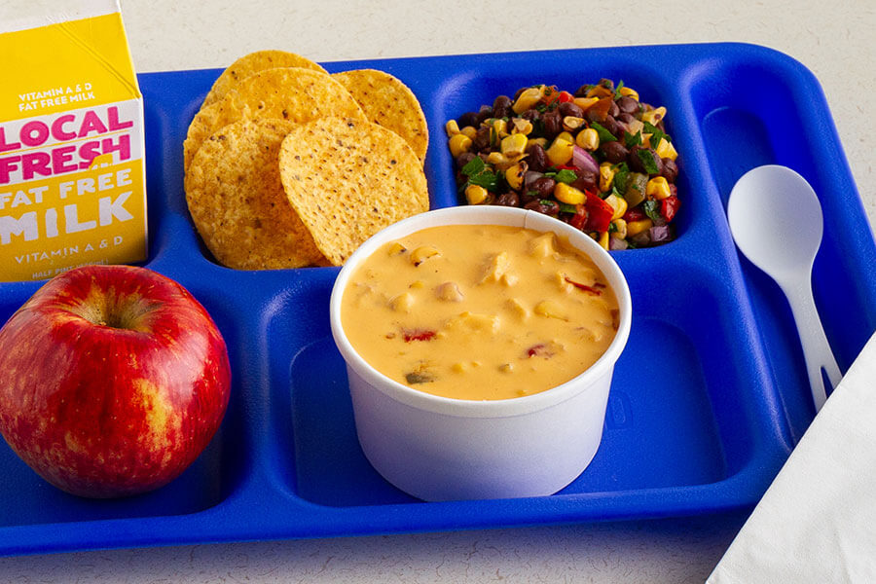
Cheesy Chicken Enchilada Soup Recipe
Child Nutrition: 2 meat/meat alternate
If a thinner consistency is desired, add more chicken broth or water. Note – this may affect final nutrition.
Global Flavors are trending in K12!
INGREDIENTS:
Land O Lakes® Ultimate Jalapeño™ Cheese Sauce
Frozen fully cooked diced chicken
Chicken broth
Frozen corn and pepper blend
Salsa
Enchiladas have a 22% penetration on School Menus!
Source: Datassentials 2025

Slide 18
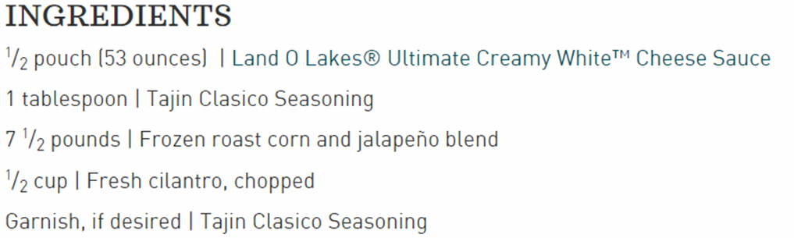


Mexican Corn Recipe Link
#39947 - Ultimate Creamy White Cheese Sauce

Slide 19




All-American Cheeseburger Mac and Cheese Recipe
#43274
Prepared 25% Reduced Sodium and 50% Reduced Fat Macaroni and Cheese with Whole Grain
Source: Datassentials 2025

Slide 20



Creamy Tomatillo Dressing Recipe
Ultimate Creamy White™ Cheese Sauce
#39947

Slide 21
Questions - Comments

Slide 22
Rick McCain
PHMcCain@LandOLakes.com
(479) 381.4001
Chef Fernando Mojica lmojicafernandez@landolakes.com
(773) 704-7708
Lo Gauna
Lorenzo.Gauna@Acxion.com
(773) 704.7708

